Slide 1
TeamWORK
Mickie Swisher
Family, Youth & Community Sciences
mesw@ufl.edu
352-273-3538

Slide 2
Objective 1: Improve your effectiveness as a team member
Understand the strengths and weaknesses of your team member style
Understand the four phases of the team-work cycle
Know the eight roles that team members can play and be able to identify them in practice
Know your personal phase and role preferences
Be able to use the strengths and weaknesses of your team member style to enhance team performance

Slide 3
What frustrates you about team work?
Oh please – not one more excuse from Jamie about why she couldn’t get her job done.
Bill is such a downer!
I can’t stand listening to Holly ramble on one more minute!
My pet peeves
I’m so frustrated I could pull my hair out!

Slide 4
What we ask of team members
To assume a new identity as a member of the team – to think of ourselves as a member of the team and act like one
To work with and trust other team members – who may be people that we would not choose as friends at all
To spend our time and effort on achieving a goal or completing a task for which the team – not the individual – will get credit

Slide 5
Your team member style
How you “act” as a team member is strongly related to your overall personality style
But your personality style expresses itself quite differently in different settings
You don’t “act” the same at a football game and in a team meeting – even though your underlying personality is stable
It expresses itself differently

Slide 6
Dimensions of style
Assertiveness
Assertive (Tells)
Unassertive (Asks)
Expressiveness
Expressive (Displays emotions)
Reserved (Controls emotions)
Task oriented
Active
Confident
Ambitious
Reserved
Easy going
Private
Deliberate
Versatile
Sociable
Extroverted
Dogmatic
Controlled
Quiet

Slide 7
Write down the ONE word from each list that best describes you.
List 1
  Thorough
  Impressive
  Analytical
  Self Reliant
  Task Oriented
  Trusting
  Understanding
List 2
  Strong Willed
  Talkative
  Motivating
  Generous
  Popular
  Action Oriented
  Adventurous

Slide 8
Write down the ONE word from each list that best describes you.
List 3
  Animated
  Powerful
  Even Tempered
  Enthusiastic
  Results Oriented
  Supportive
  Orderly
List 4
  Patient
  Cooperative
  Outgoing
  Precise
  Hard Driving
  Technical
  Challenging

Slide 9
Write down the ONE word from each list that best describes you.
List 5
  Diplomatic
  Charismatic
  Candid
  Accommodating
  Sentimental
  Stimulating
  Spontaneous
List 6
  Lively
  Diligent
  Detail Oriented
  Authoritative
  Meticulous
  Appreciative
  Accurate

Slide 10
Write down the ONE word from each list that best describes you.
List 7
  Consistent
  Dramatic
  Optimistic
  Agreeable
  Competitive
  Logical

Slide 11
Your Team Member Style
Action Oriented
Adventurous
Authoritative
Candid
Challenging
Competitive
Hard Driving
Impressive
Powerful
Results Oriented
Self Reliant
Strong Willed
Direct

Slide 12
Animated
Charismatic
Dramatic
Enthusiastic
Lively
Motivating
Optimistic
Outgoing
Popular
Spontaneous
Stimulating
Talkative
Spirited

Slide 13
Accommodating
Agreeable
Appreciative
Cooperative
Diplomatic
Even Tempered
Generous
Patient
Sentimental
Supportive
Trusting
Understanding
Considerate

Slide 14
Accurate
Analytical
Consistent
Detail Oriented
Diligent
Logical
Meticulous
Orderly
Precise
Task Oriented
Technical
Thorough
Systematic

Slide 15
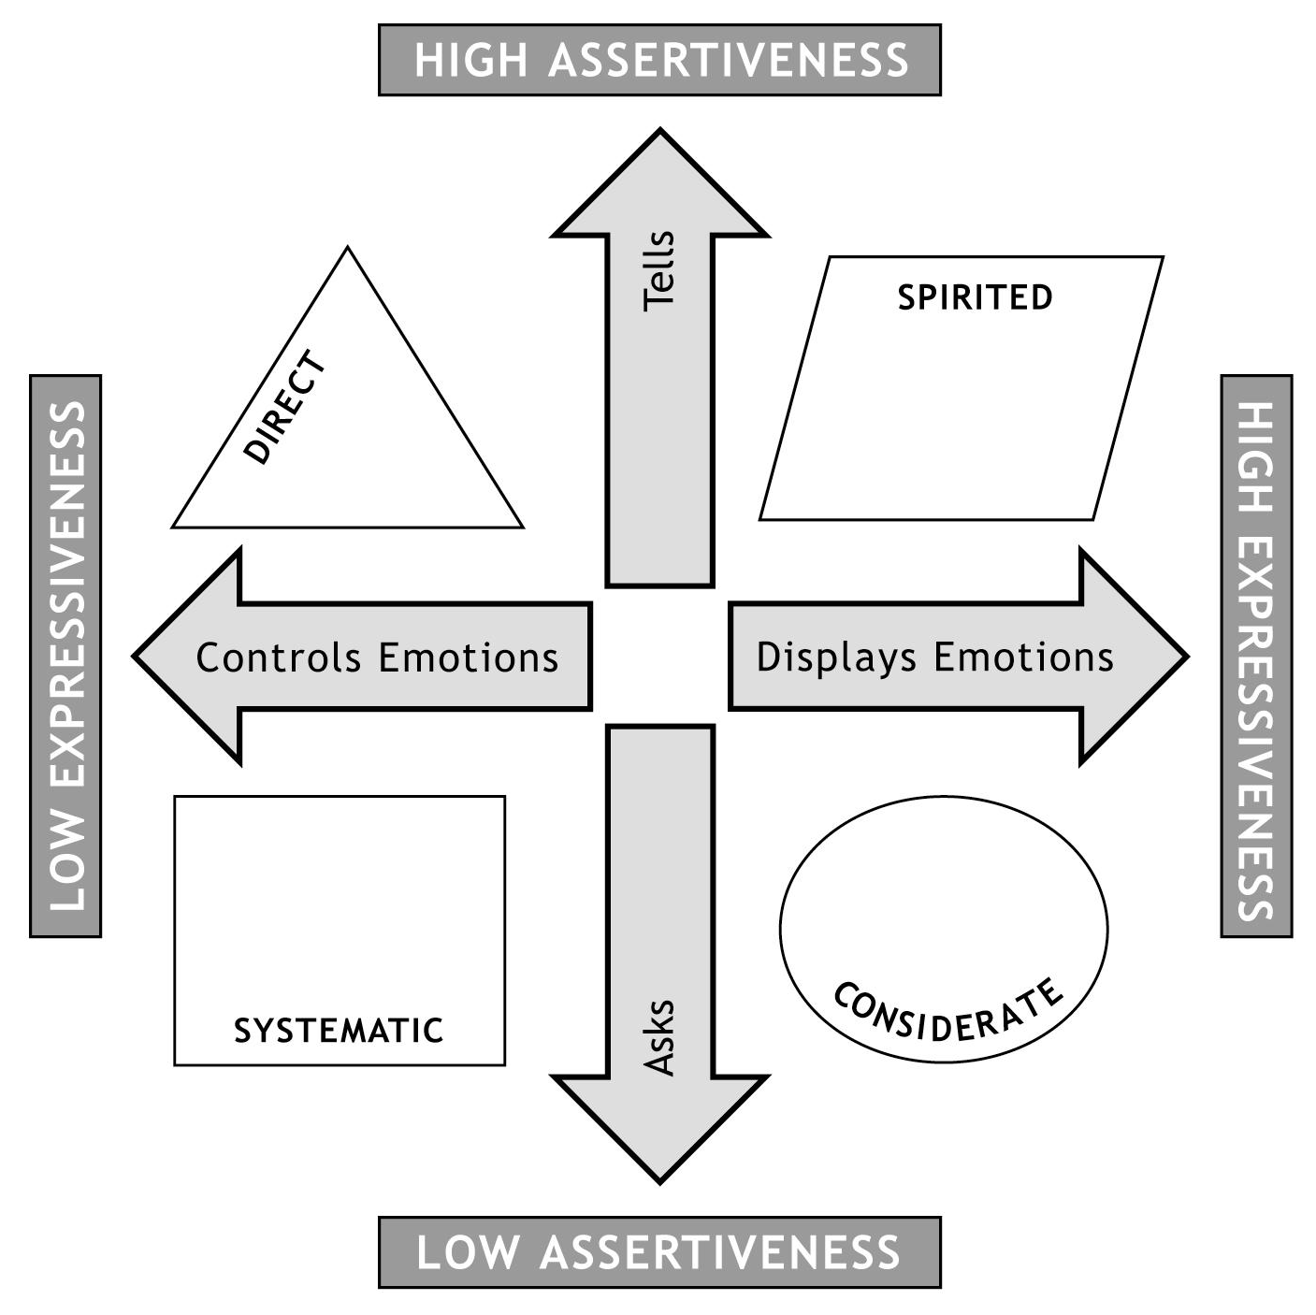
Team Member Style Profile

Slide 16
Team Member Styles
DIRECT
Assertive, forward thinking
SPIRITED
Energetic, creative
CONSIDERATE
Thoughtful, supportive
SYSTEMATIC
Consistent, well-organized

Slide 17
Direct Style
Focuses on the big picture
Believes that conflict can be constructive
Takes risks
Communicates assertively
Loves generating new ideas
Open to change
Recognizes and praises the accomplishments of others
Has lots of energy & enthusiasm
.
Strengths
Trouble Spots

Slide 18
Spirited
Generates excitement
Is spontaneous
Has good persuasive skills
May exaggerate
May become over-dramatic
Strengths
Trouble Spots

Slide 19
Considerate
Listens actively
Considers others’ feelings
Is patient
May avoid conflict
May give in easily
Strengths
Trouble Spots

Slide 20
Systematic
Makes decisions based on facts
Is analytical
Stays calm and rational
May become bogged down in details
May be impersonal
Strengths
Trouble Spots

Slide 21
THE TEAM-WORK CYCLE
1.
INITIATION
7
Notes:
ANIMATION: None.
COMMENTARY: “Let’s look at each phase in more detail.”

Slide 22
Phase 1: Initiation
The first phase of the Team-Work Cycle occurs when the task is defined.
The task may be a need to be satisfied, a question to be answered, an issue to be resolved, a decision to be reached, a goal to be met, a problem to be solved, a project to be completed, or any of several other types of work.
In this stage it is important to specify as concretely as possible what the task is and the results desired when the task is completed.
Failure in this phase may result in aimless floundering, wasted efforts, and/or dissolution of the work team in later stages.

Slide 23
THE TEAM-WORK CYCLE
1.
INITIATION
⇩
2.
IDEATION
9
Notes:
ANIMATION: Arrow appears at first mouse click after the initial slide change. Title of phase appears at next click.
COMMENTARY: “Once the first phase has been completed, the phase called Ideation should be next for a team to enter.”

Slide 24
Phase 2: Ideation
In this phase, alternative ways to approach the task are generated.
These options may be potential need satisfiers, answers to questions, possible problem solutions, ways to reach a goal, means of making decisions, designs for completing a project, or several other types of approaches to a task.
It is important to produce a number of ideas about how to do the defined task. Originality, applicability to the work to be performed, and variety are important.
Failure in this phase may result in habitual, limited approaches to a task. Such rigidity can lead to mis-directed efforts, loss of effectiveness, and low team morale.

Slide 25
THE TEAM-WORK CYCLE
1.
INITIATION
⇩
3.
ELABORATION
2.
IDEATION
⇦
11
Notes:
ANIMATION: Arrow appears at first mouse click after the initial slide change. Title of phase appears at next click.
COMMENTARY: “The phase which a team should go to next is called … Elaboration.”

Slide 26
Phase 3: Elaboration
The third phase involves the elaboration of alternative ways to accomplish the task.
The essential job in Elaboration is to try to make ideas work — to “flesh out the skeletons” of various alternatives, in real terms. Answers to reality-oriented, “hard” questions are needed.
It is important to examine possible conflicts among people in making these plans, as well as defining the best ways to utilize human resources. Similarly, conflicts between time schedules, budgets, equipment, and other physical resources must be thought through.
Failure to complete this phase adequately may result in conflicts that could jeopardize the task and the team’s continued survival.

Slide 27
THE TEAM-WORK CYCLE
4.
COMPLETION
1.
INITIATION
⇧
⇩
3.
ELABORATION
2.
IDEATION
⇦
Notes:
ANIMATION: Arrow appears at first mouse click after the initial slide change. Title of phase appears at next click.
COMMENTARY: “The last phase of the Team-Work Cycle is entitled Completion.”

Slide 28
Phase 4: Completion
The last phase occurs when the alternative approaches are considered and evaluated, one is chosen, and work is performed.
This phase requires perceptive analysis of real situations, use of appropriate criteria to evaluate options and to measure results, and the ability to carry out plans in the real world. Similarly, perseverance in doing detailed work is required. This is where ideas and plans are put to the test.
It is important to weigh costs and benefits, to compute the bottom line, and to calculate the odds for success and failure of the task.
Failure to complete this phase adequately may result in errors, wasted energy, possible failure of the task, and dissatisfaction of team members.

Slide 29
Your Preferred Team Work
Think about any team of which you are a member right now.
Write down:
  Three things you like most doing as a team member
  Three things you like least doing as a team member

Slide 30
Oppositional Team Roles
Leader - Manager
Leader wants to get it done!
Manager wants to get people to work together
Moderator - Organizer
Moderator wants everyone’s input
Organizer wants to structure the process
Creator - Evaluator
Creator wants to get lots of ideas on the table
Evaluator wants to prioritize, pare it down
Innovator – Finisher
Innovator wants to take advantage of every opportunity
Finisher wants to complete one task before starting another

Slide 31
TEAM-WORK &
TEAM-ROLES MODEL
⇨
4. COMPLETION
1. INITIATION
Finisher
Leader
Evaluator
Moderator
⇧
⇩
Organizer
Creator
Manager
Innovator
3. ELABORATION
2. IDEATION
⇦
92
Notes:
ANIMATION: None.
COMMENTARY: None.

